Slide 1
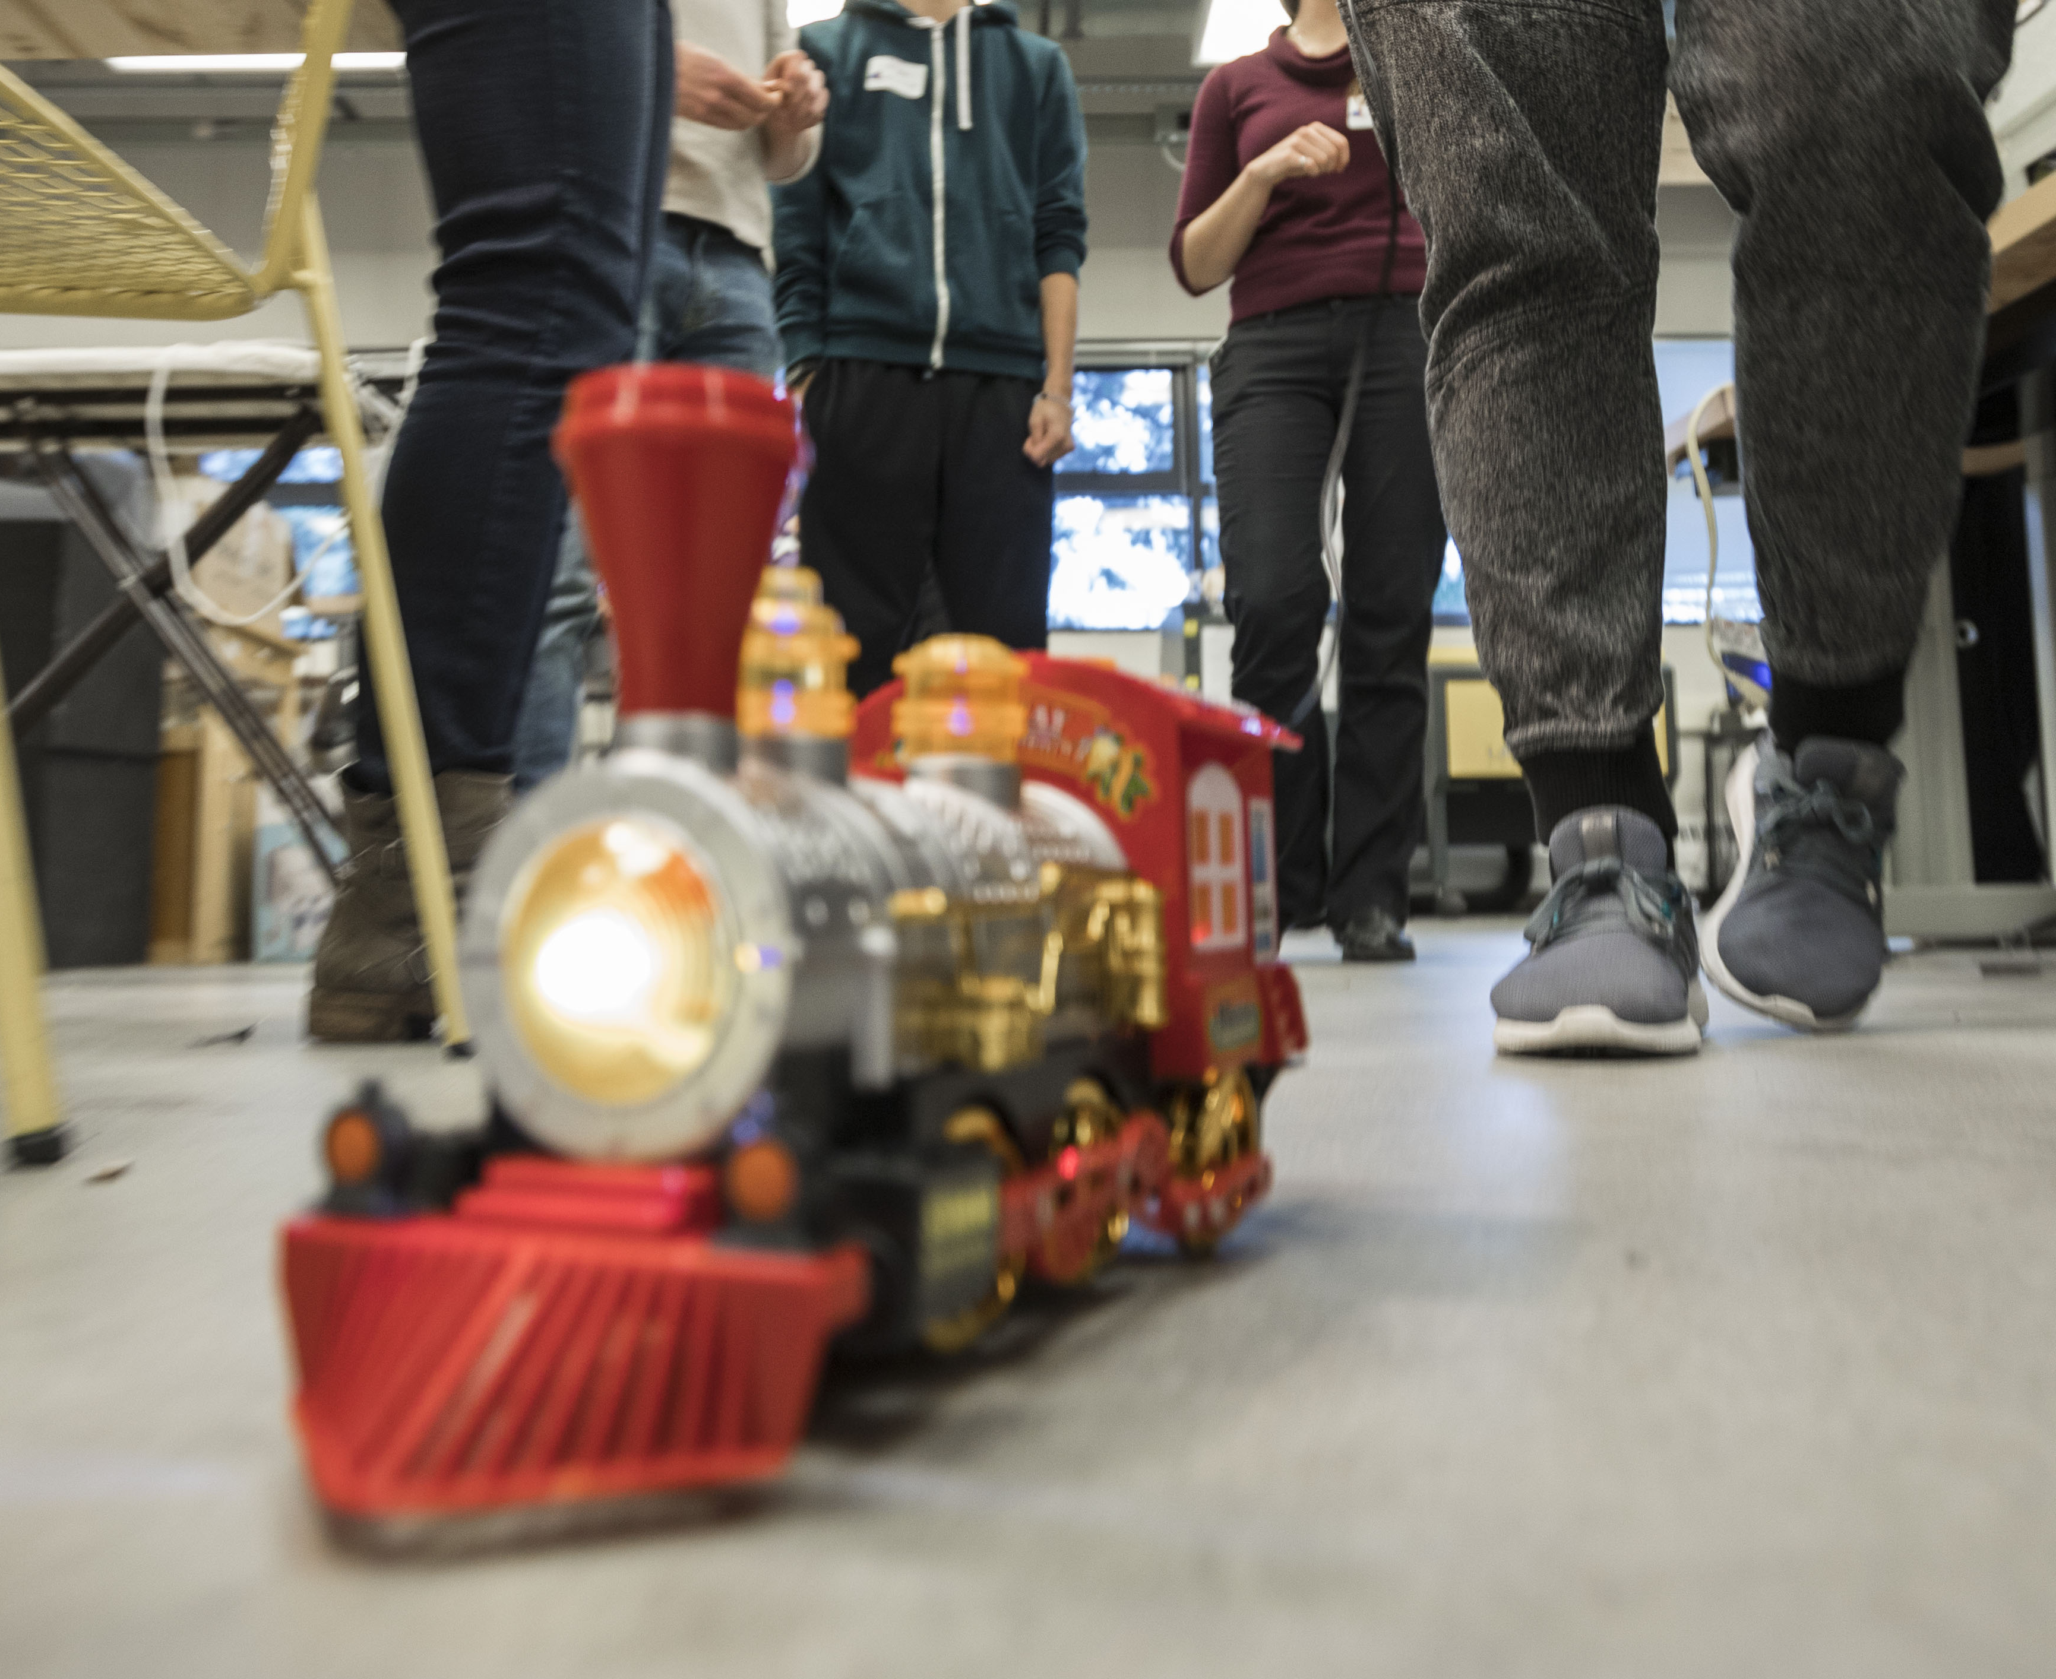
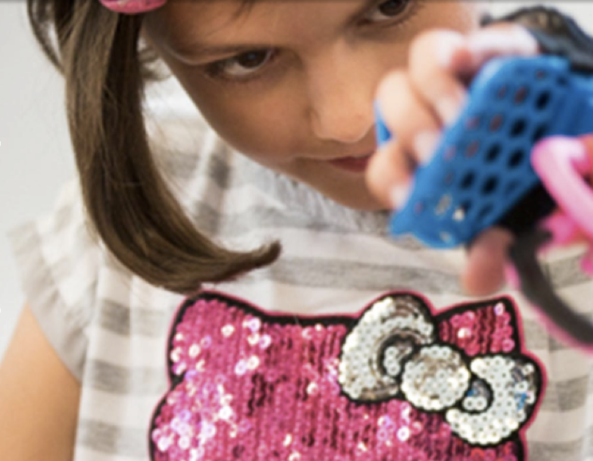
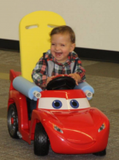
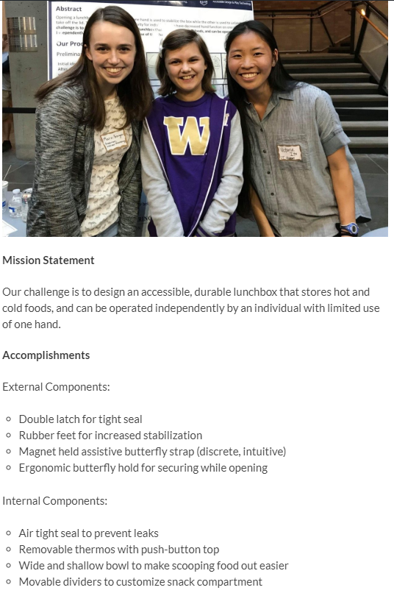
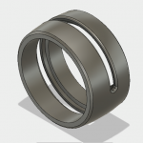
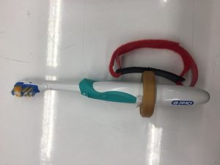
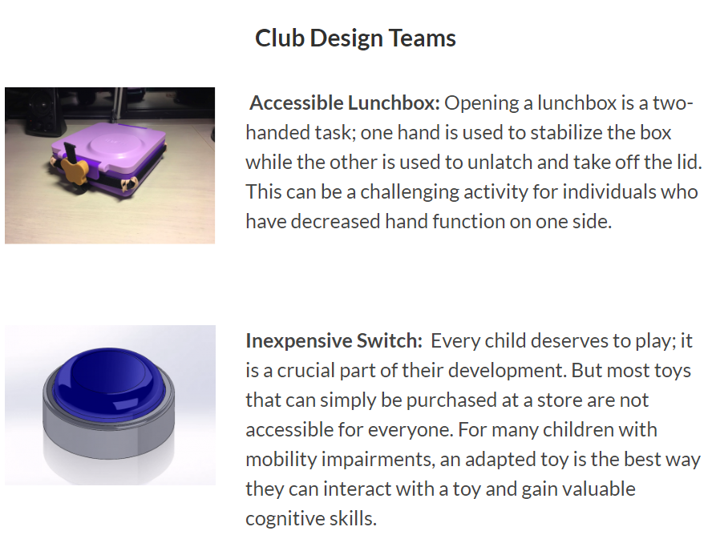
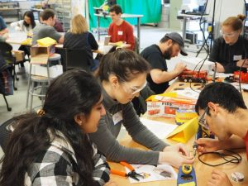
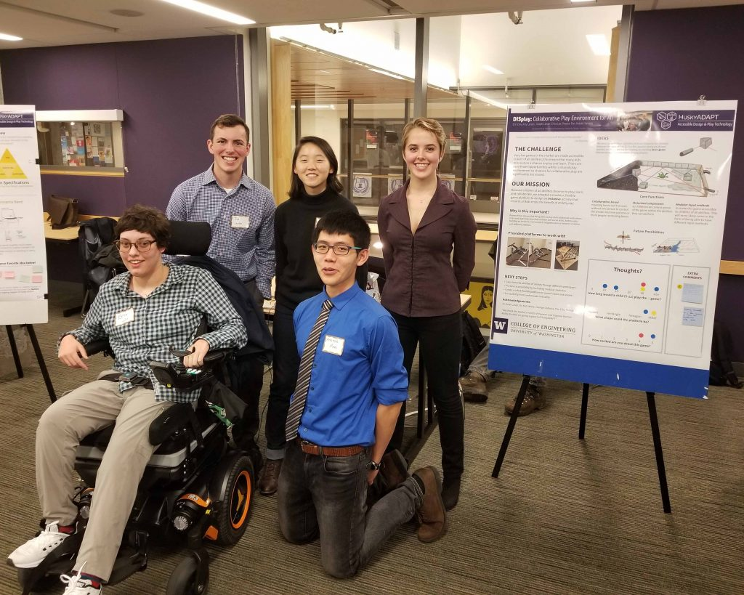
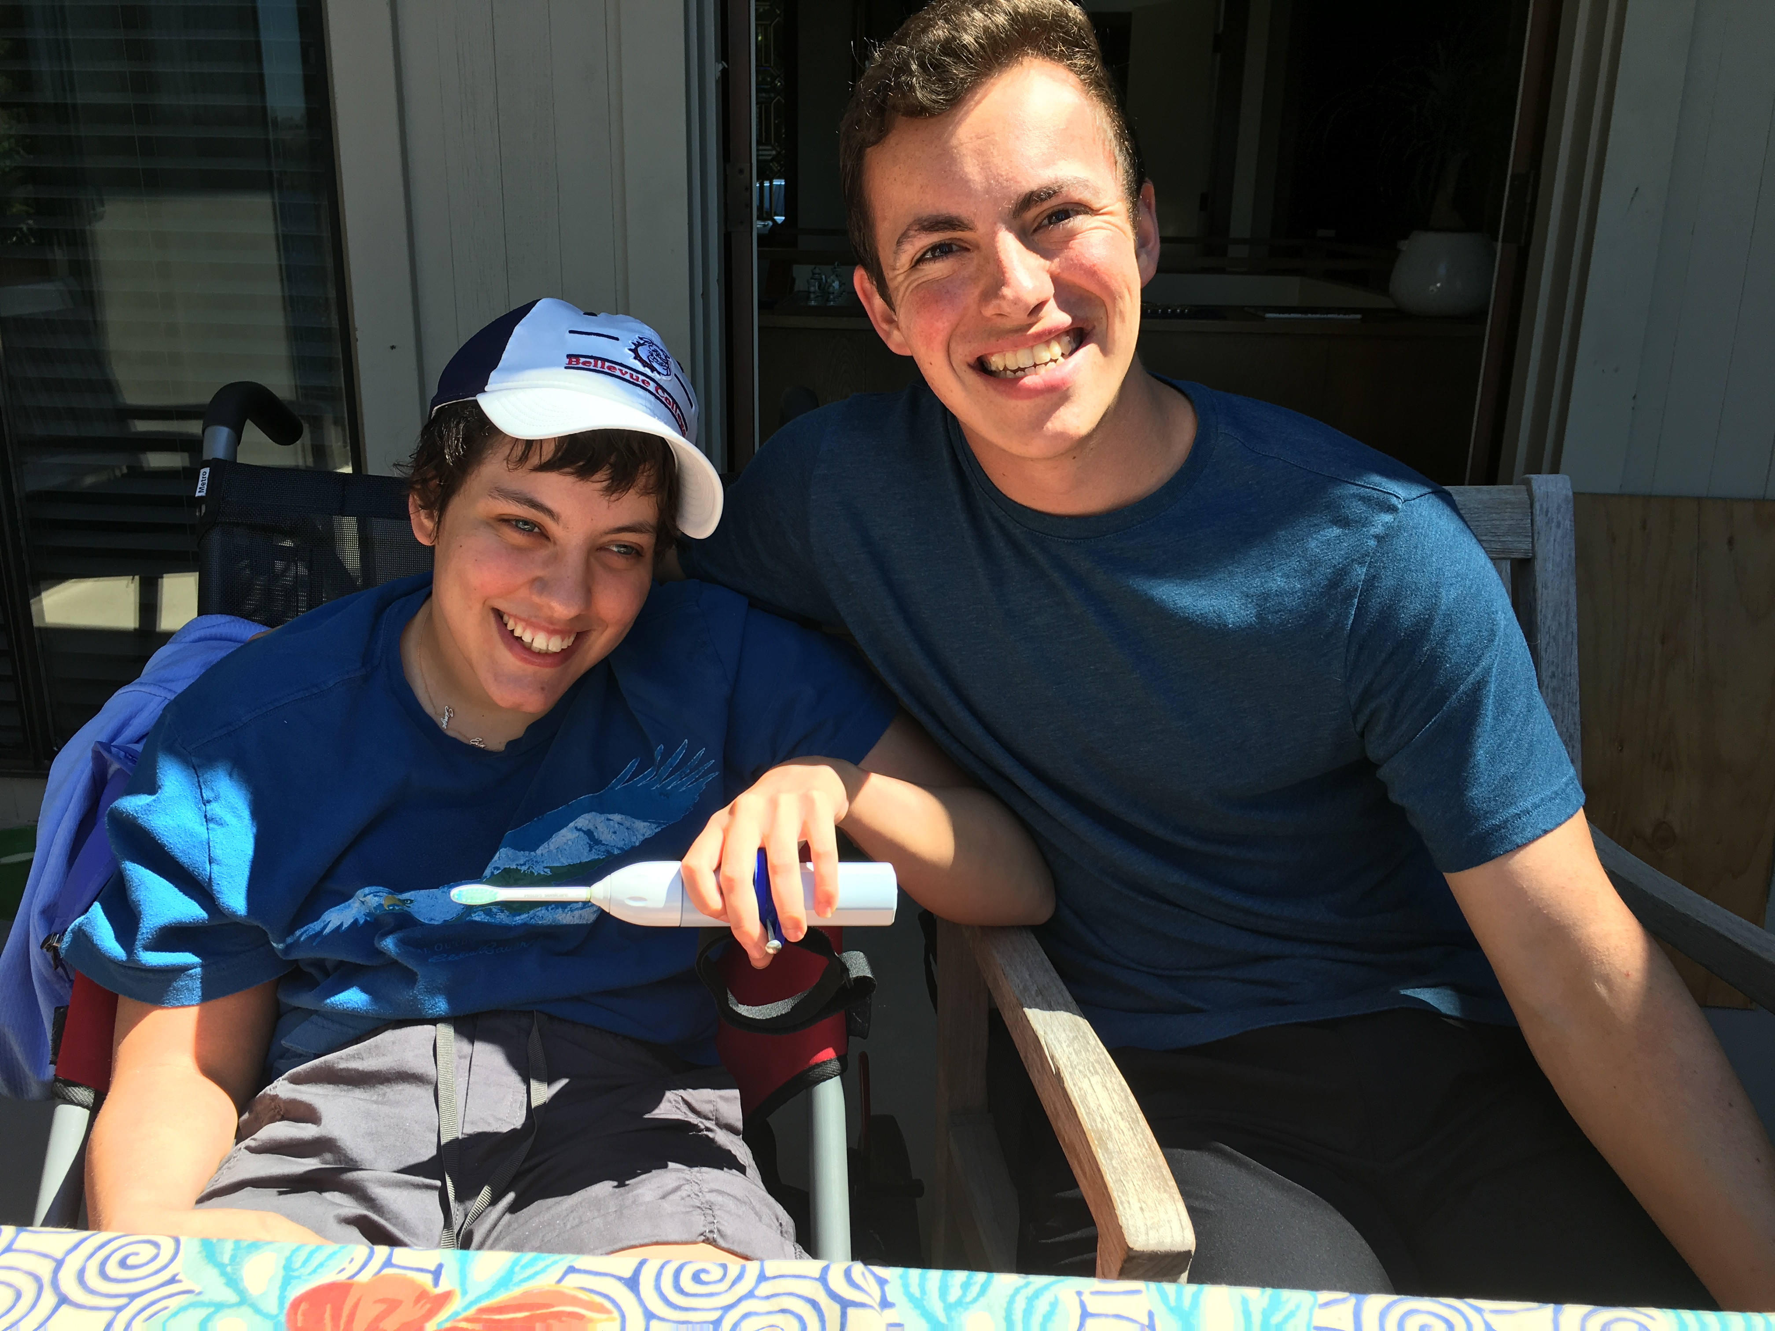
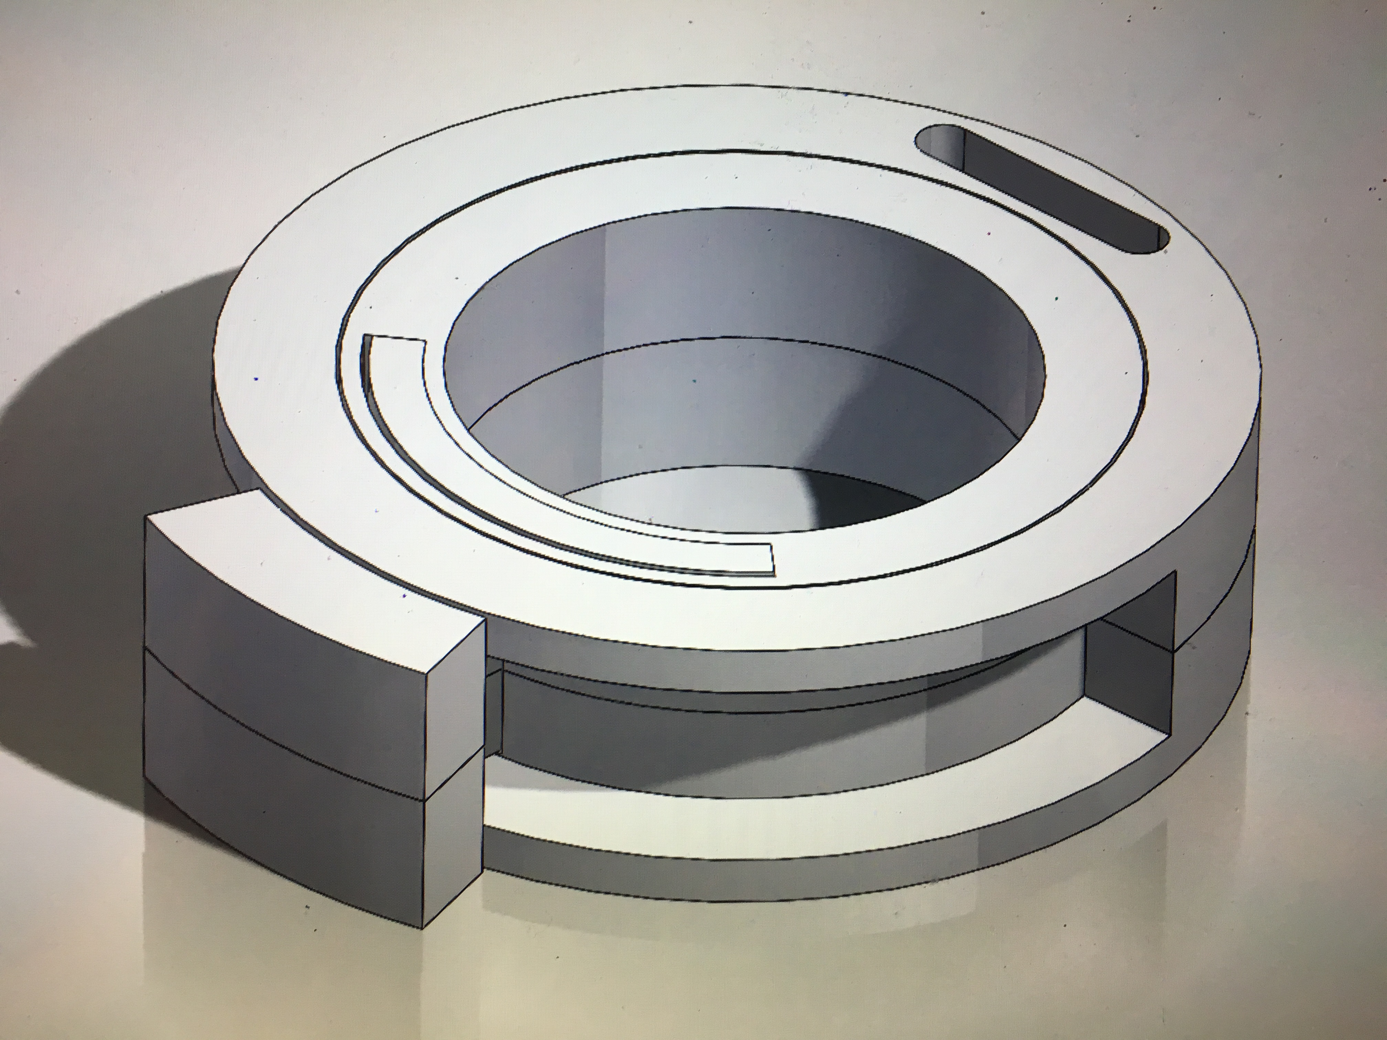


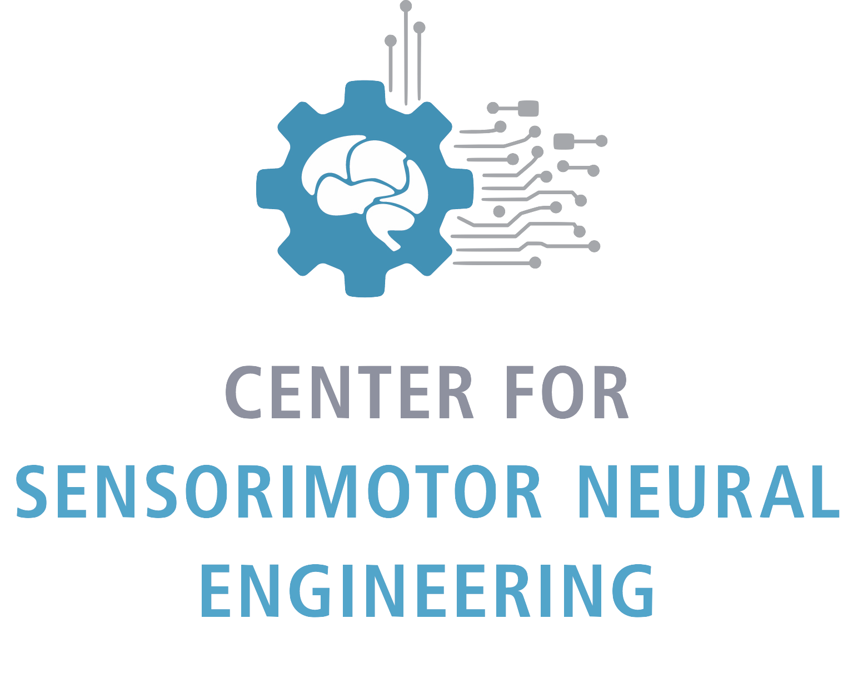
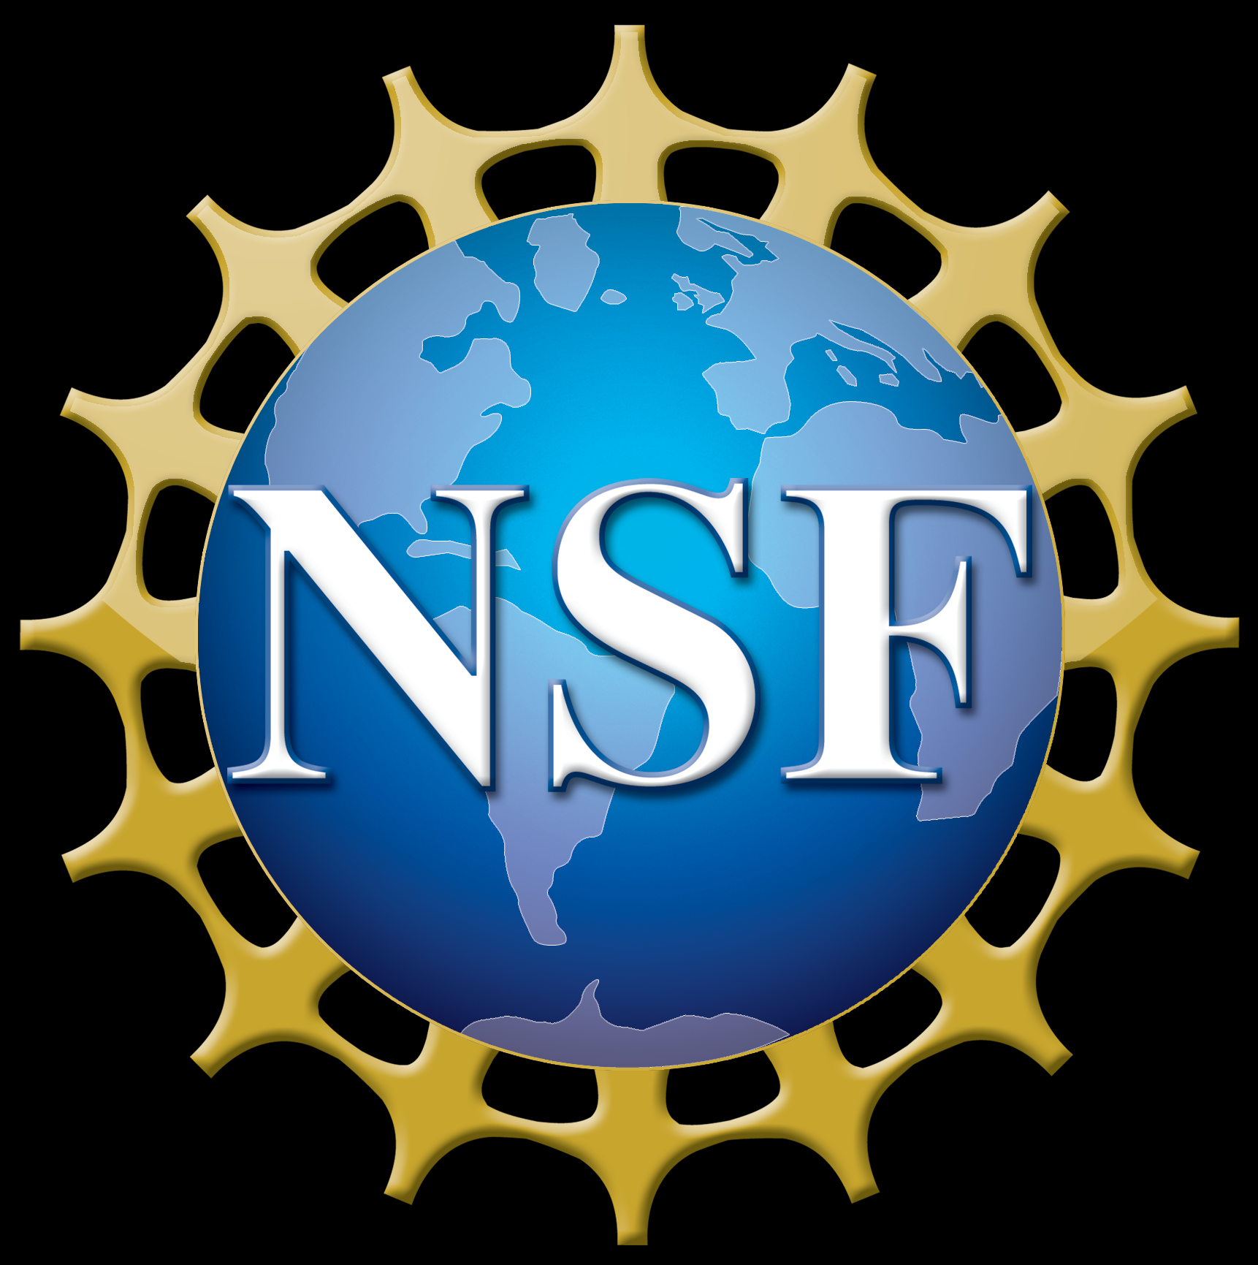

Size of font
Establishing an inclusive and sustainable design program for assistive technology
Joseph J. Lawler, Keshia M. Peters, Alyssa M. Spomer and Katherine M. Steele
Mechanical Engineering, University of Washington, Seattle, WA
What is HuskyADAPT?
What is Accessible Design?
What makes a program sustainable?
HuskyADAPT stands for Accessible Design and Play Technology; the program just completed its first year and is already incredibly successful
A program that teaches students about inclusive design through toy and ride-on car adaptation and year-long design projects
A design process in which the needs of people with disabilities are specifically considered [1]
Focused on preservation and transfer of information
Information is organized in a way allowing others to learn from, replicate, and iterate upon our work
Design Projects 2017-2018
Furthering a Design Project
Design Challenges 2018-2019
How do we ensure sustainability of projects between years? How do we share results with the broader community?
How can we help individuals with limited hand function perform daily hygienic tasks?
How do we reach out to need experts for design project ideas and partnerships? How do we pick design projects for impact?
Need:
A website that ensures the sustainability of the club and showcases past accomplishments
Process:
Investigated current models for showcasing research and projects
Posted mission statement, accomplishments, next steps and GitHub repository for each team
Incorporated accessibility features
Product:
Need:
A modular system that allows individuals with varying dexterity foster greater independence in their daily life, specifically to manipulate a toothbrush
Product:
Team Cajun created a tool that allows the user to effectively manipulate a variety of objects
Final design allows full rotation laterally and an axial rotation of 270 degrees
Thin lightweight design
offering maximum mobility
Continuation:
Design a tool specifically for need expert Erin Ciliv
- A need expert is a community member who provides invaluable insight on a particular disability
Iterated through three designs based off user feedback
Device builds upon Erin's ability with her left hand; rotates toothbrush 180 degrees
Need:
System for reaching out to need experts and creating design challenges for next year
Product:
Need Expert Survey –document to collect design ideas and set expectations for team members; incorporated feedback from experts in the field
Centralized repository –document containing contact information of all of our community members
Interview guidelines –document to be utilized in meetings with need experts, ensures the correct information is gathered
Design Challenges –one page summary of each design challenge for incoming student teams, providing detail and direction
Central Page for teams; images link to detailed team pages
Mouseover hover feature
Future:
Documentation will be used in upcoming meetings with need experts to prepare design challenges, continue to iterate upon the format based off of feedback
Continue to expand our network of community members
Alternative Text
The website workflow is now more intuitive and organized so the information is accessible. There is now a system in place for future teams to upload their documentation.
Building upon team Cajuns work, I was able to design a similar device specifically for need expert Erin Ciliv. Erin now has the ability to brush her teeth with just her left hand.
Student teams and need experts are set up for success by establishing realistic expectations and desired outcomes before the design process even starts.
References
1. Washington.edu. (2018). What is the difference between accessible, usable, and universal design? | DO-IT
Acknowledgments
I would like to thank the HuskyADAPT faculty, design team Cajun, Erin Ciliv and her family for their advice and direction throughout this project. I also thank the Mathers Fund to Empower and Improve Human Ability for their ongoing support of HuskyADAPT.

